Slide 1
CoDE FOR LIBERATION March 8, 2016
Speaker: Kate Krauss
ailanthus@riseup.net
pgp key id: 7D18 973B
Notes:
7D18 973B

Slide 2
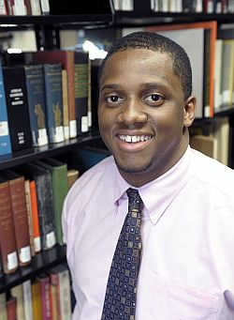
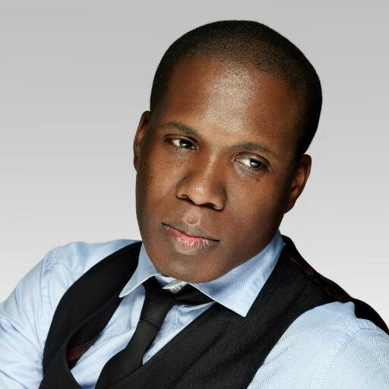
Thank you.
I tell you they are making history.
Jarrett Drake, Archivist, Princeton University
Matthew Mitchell,
Data Journalist and Organizer, New York City

Slide 3
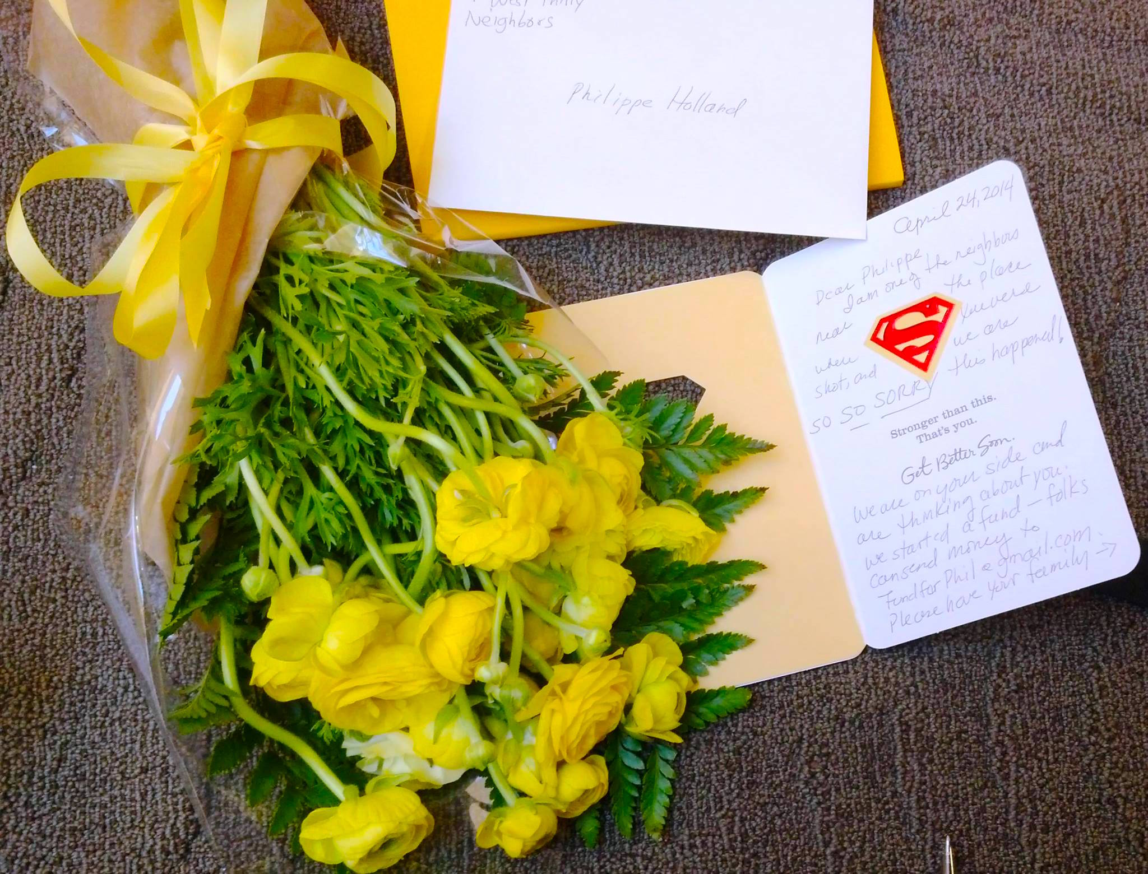
April, 2014

Slide 4
Police Misconduct
1140 US civilians were killed by police in 2015 according to The Guardian newspaper.
Few police are ever prosecuted.
No national database exists, although the Attorney General requested one in 1994.

Slide 5
Librarians are embedded in the community, you are distributed, and you are trusted.

Slide 6
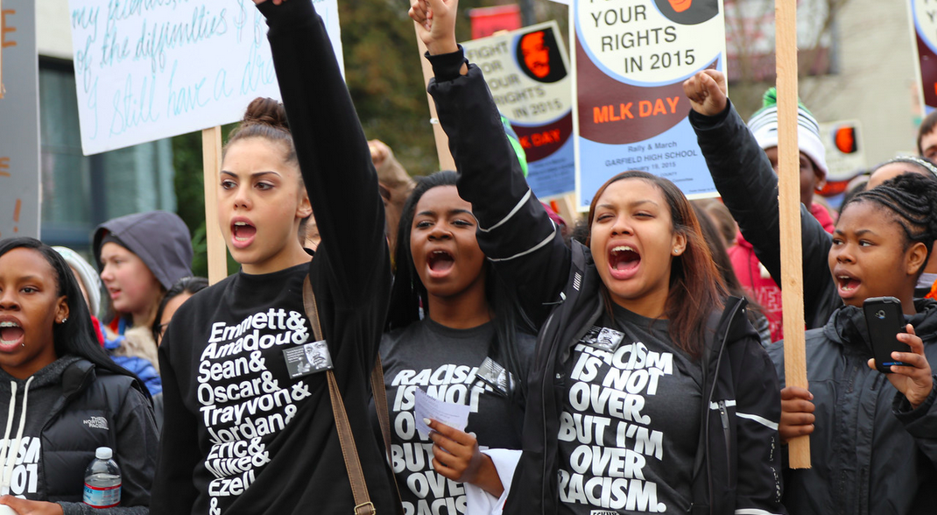
Black Lives Matter
Notes:
One of the groups I chose was the Movement for Black Lives (Black Lives Matter)

Slide 7
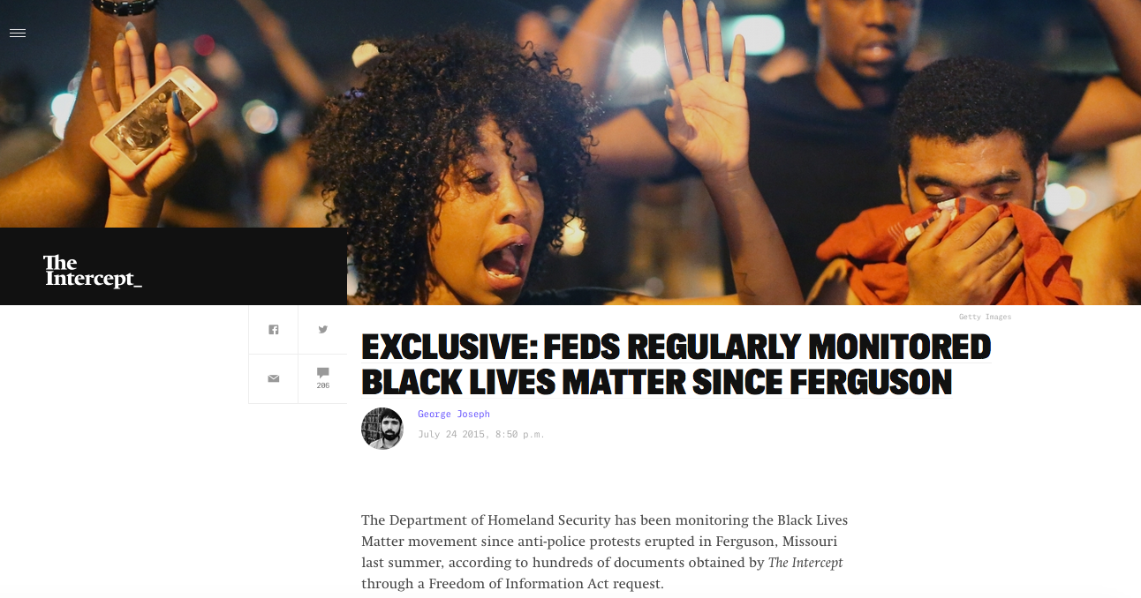
Who is being watched?

Slide 8
Trajectory of Surveillance
Black Lives Matter: FBI is currently monitoring them on social media, including location (what we know so far)
Occupy Wall Street: Surveilled by Homeland Security, the Joint Terrorism Task Force, the Naval Criminal Investigative Service, even the Federal Reserve; devices were scanned by law enforcement using IMSI Catchers. Infiltrated by police.
1950s-1960s Civil Rights Movement: COINTELPRO ☹

Slide 9
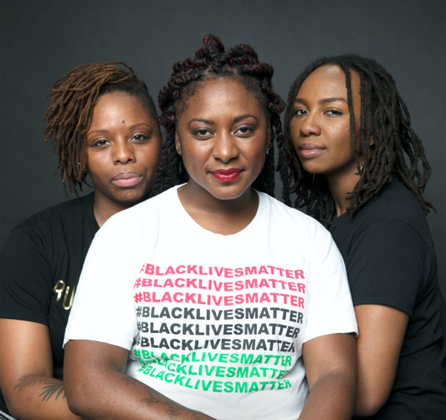
Founders of Black Lives Matter
Patrisse Cullors, Alicia Garza and Opal Tometi.

Slide 10
"If you are neutral in situations of injustice, you have chosen the side of the oppressor."
-- South African Archbishop Desmond Tutu

Slide 11
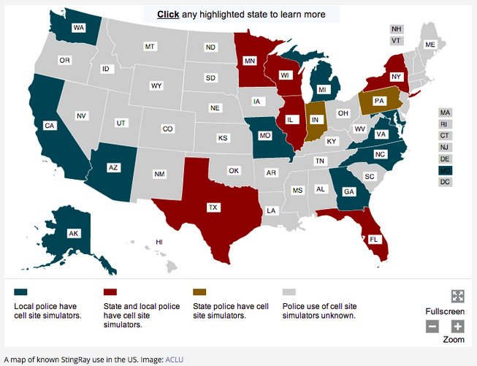
IMSI Catchers

Slide 12
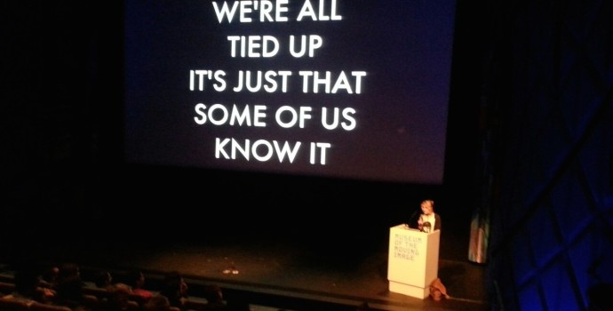
(Meet trans activist, game developer, and public intellectual Merritt Kopas)
Notes:
Second community I want to highlight is the transgender community. Having a big year in pop culture, with TransParent, the Danish Girl, and a series of articles in the New York Times

Slide 13
National Transgender Discrimination Survey by the National Center for Transgender Equality (n =6,450)
Forty-seven percent (47%) said they had experienced an adverse job outcome, such as being fired, not hired or denied a promotion because of being transgender or gender non-conforming.
Many respondents lived in extreme poverty; they were 4x more likely to have a household income of ( <$10,000) than the general population.
11% of transwomen in the study had engaged in sex work.

Slide 14
“I don’t know a data model that isn’t politically charged.”
– Jarrett Drake, archivist, Princeton University

Slide 15
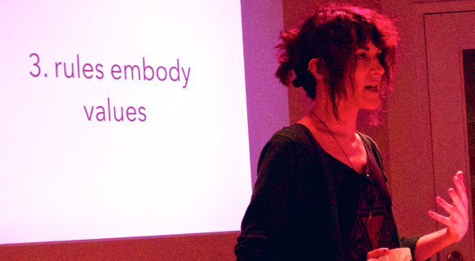
Merritt reminds us:

Slide 16
Aeon (system for managing access to special collections)
Asks for birthday, home addresses, phone numbers
Data can be accessed by many members of library staff
Saved data can be subpoenaed by law enforcement
How long is this data saved? FOREVER
If you work with Aeon: Your work is inherently political.
Notes:
Not trying to gang up on Aeon– but we need to think a

Slide 17
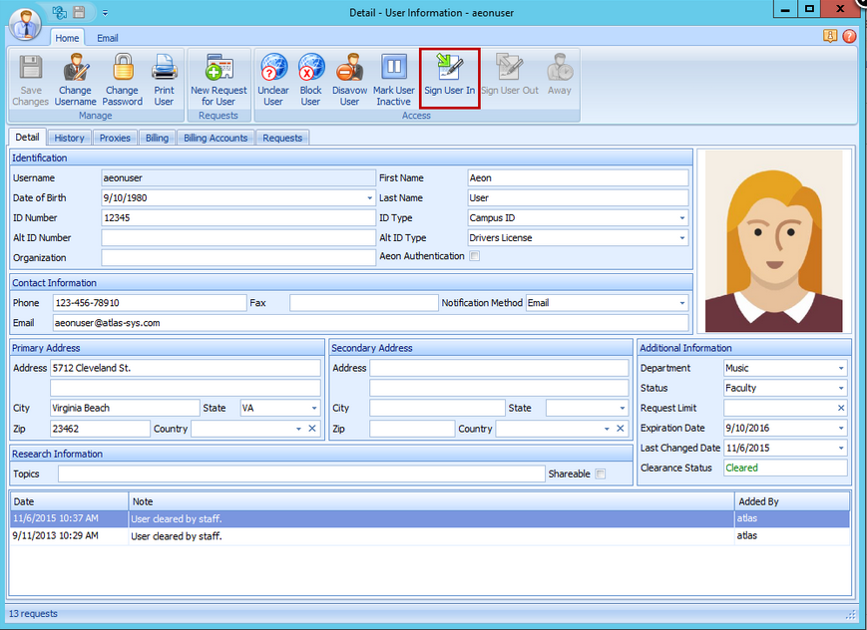
Who are you watching?
Notes:
AY ON

Slide 18
The decisions you make about what to collect, what to retain, what to distribute and who can see it are politically charged and they are moral choices.

Slide 19
“The library profession has a
long-standing commitment to an ethic of facilitating, not monitoring, access to information.”
– American Library Association, 2002
Notes:
----- Meeting Notes (3/8/16 03:23) -----
ccc

Slide 20
Who’s Watching You?

Slide 21
Watch six minute film by Laura Poitras on the Intercept website about German systems administrators surprised to learn that they were more valuable surveillance targets than they imagined:
http://interc.pt/Zl8d5R
Notes:
CHOKEPOINT FILM IS HERE

Slide 22
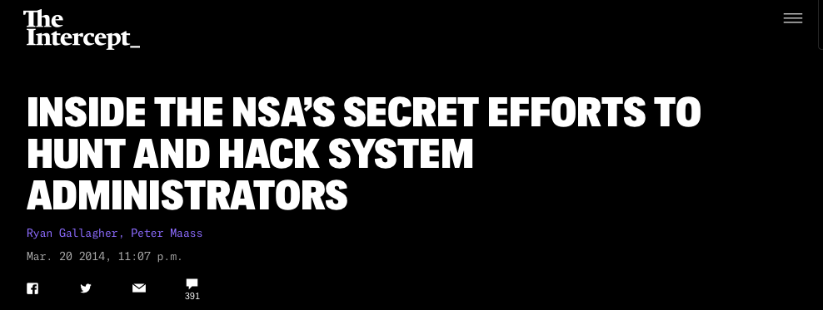

Slide 23
“One of the NSA’s
worst nightmares is a sysadmin who pays attention.”
--Rob Joyce, National Security Agency’s Tailored Access Operations
(NSA’s hacking group)

Slide 24
Whose data do you protect?
Politicians
Political activists like Black Lives Matter
LGBTI community members
People researching sensitive health issues
Schoolchildren (who will someday be adults)
Library staff
Documented and undocumented immigrants including
Political asylum seekers
Domestic violence survivors

Slide 25
Ideas for Action
Follow ethical data collection and retention rules that put library users first.
Hold people who violate those rules accountable: Is It Time for a Library Whistleblowing Platform?
Make your systems as secure as possible.
TEACH ONLINE PRIVACY WORKSHOPS.
Publish a privacy report.
Teach users about the stakes of online surveillance: If you don’t have privacy online, you don’t have privacy.
Run a Tor relay and offer users Tor to browse anonymously.
Walk the talk: Use Signal and Tor

Slide 26
More Ideas for Action
Examine access rules—
What information are you making it difficult to access?
What data must a user give up to access which material? What is freely available?
What are the social and political implications of these decisions?

Slide 27
More Ideas for Action Create special collections for users: “Create a Black Feminist and Womanist section of books on hand so folks have a fuller understanding of the intersections of oppression: Audre Lorde, Alice Walker, etc.” “Create an Afrofuturism section so people can read and dream about worlds free from systems of oppression (Octavia Butler, Virginia Hamilton, and Nnedi Okorafo)”

Slide 28
Create a collection for people who want to bring themselves up to speed on the movement for Black lives!
--And race in America in general, including the history of policing

Slide 29
DC Public Library’s Privacy Month!

Slide 30
DC Library Privacy Month
Livestreamed read-a-thon of Orwell’s 1984
Privacy workshop for teens
Reading and discussion of Nineteen Eighty-Four by George Orwell, Dragnet Nation by Julia Angwin, Little Brother by Cory Doctorow
Films: United States of Secrets, The Internet's Own Boy, 1984
Workshops on privacy tools, including Tor
Panel discussion on privacy at the Newseum
http://dclibrary.org/1984 ☺

Slide 31
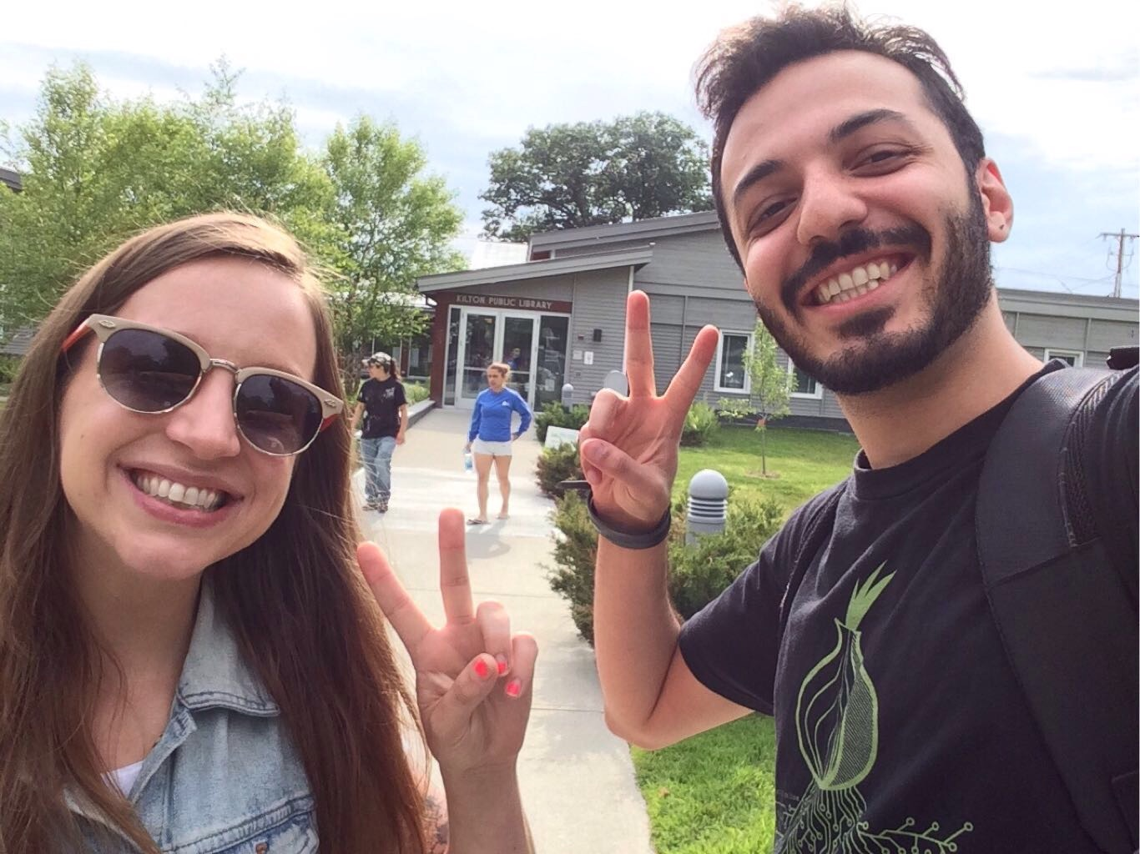
IT LIBRARIANS CAN CHANGE THE WORLD!
(Photo by Nima Fatemi)
Notes:
Alison Macrina and Nima Fatemi, BE LIKE ALISON!

Slide 32

CryptoParties. Invented by Asher Wolf in 2012.
Asher is a digital rights activist based in Melbourne, Australia.
- She has 40,000 Twitter followers.
Notes:
Asher Wolf

Slide 33
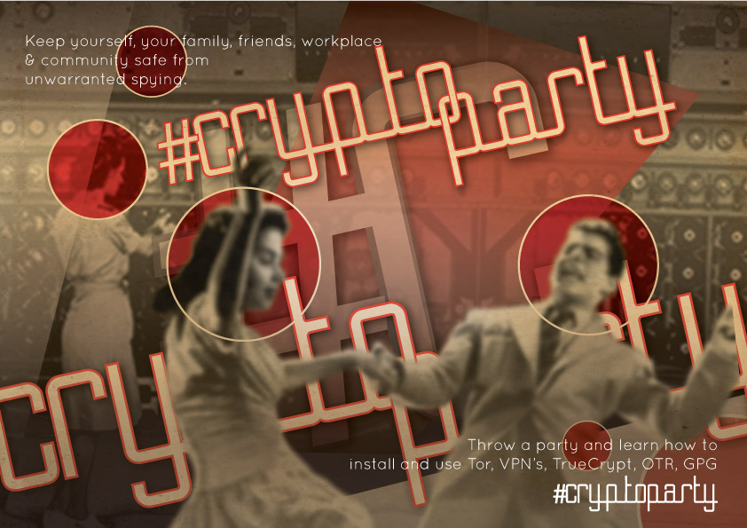
CryptoParty Poster

Slide 34
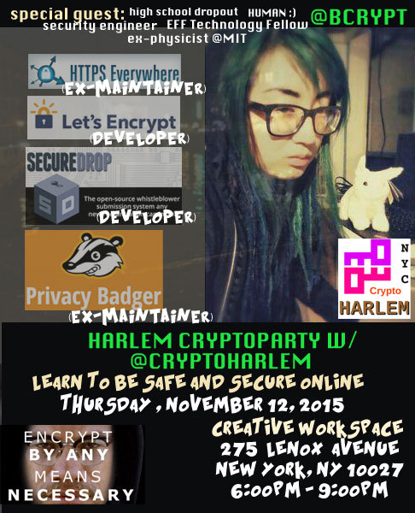
CryptoParty Harlem in Action

Slide 35
Model for an Unconference
Invite new friends
Invite allies of new friends
Eat
Really listen– how does their day go? What devices and programs do they use?
Brainstorm
Listen with great kindness
Eat more
Continued
What are people’s needs?
Break out sessions, more listening
Is there an event, a tool, a policy, that the community says would help?
Make a plan (bring list of needs to hackathon?)
Rinse and repeat

Slide 36
ALA Resolution on the Retention of Library Usage Records
Limit the degree to which personally identifiable information is collected, monitored, disclosed, and distributed; and
Avoid creating unnecessary records; and
Limit access to personally identifiable information to staff performing authorized functions; and
Dispose of library usage records containing personally identifiable information unless they are needed for the efficient and lawful operation of the library, including, but not limited to data-related logs, digital records, vendor-collected data, and system backups

Slide 37
(ALA Data Retention Policy Continued)
Ensure that the library work with its organization's information technology unit to ensure that library usage records processed or held by the IT unit are treated in accordance with library records policies; and
Ensure that those records that must be retained are secure; and
Avoid library practices and procedures that place personally identifiable information on public view; and
Assure that vendor agreements guarantee library control of all data and records; and
Conduct an annual privacy audit to ensure that information processing procedures meet privacy requirements by examining how information about library users and employees is collected, stored, shared, used, and destroyed

Slide 38
Thank you
Jarrett Drake
Matt Mitchell
Alison Macrina
Nima Fatemi
Merritt Kopas
ACT UP
Griffin Boyce
Erika Totten
Maureen Callahan
Jacob Appelbaum
Anonymous (3)
Notes:
Act up, which taught me how power works

Slide 39
Give me six lines written by the hand of the most honorable of men, and I will find something in them which will hang him.
--Cardinal Richelieu

Slide 40
CoDE FOR LIBERATION March 8, 2016
Speaker: Kate Krauss
ailanthus@riseup.net
Twitter hashtag: #c4l16
pgp key id: 7D18 973B
Notes:
7D18 973B

